Slide 1
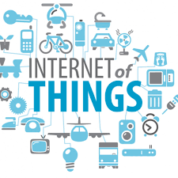

Slide 2
OUTLINE
INTRODUCTION
APPLICATIONS
DISADVANTAGE

Slide 3
INTRODUCTION
The network of things embedded With electronics, software, network Connectivity and sensors, which enables these Objects to collect and exchange data.

Slide 4
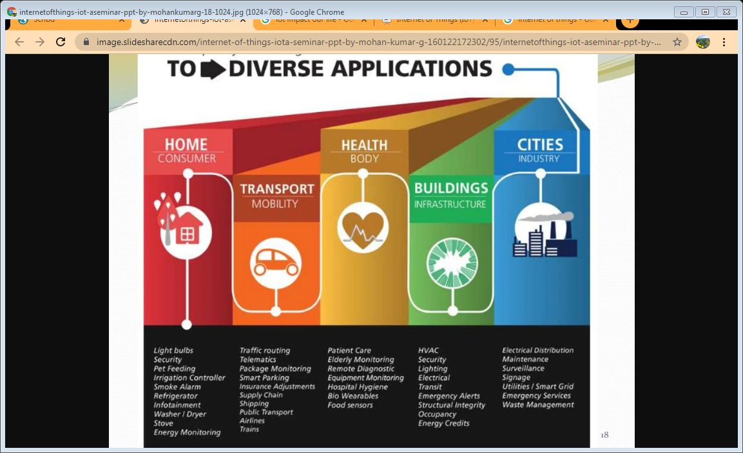
APPLICATIONS

Slide 5
REDUCES HUMAN INVOLVEMENT AND ENERGY COSTS BY USING REAL-TIME DATA FROM SENSORS TO MONITOR.
HELPS BUSINESS TO IMPROVE WORKPLACE SAFETY BY USING SENSORS

Slide 6
Super reliance on technology
Privacy issue
Becoming indolent
DISADVANTAGES

Slide 7
Thank you
By Upasana

